Slide 1


IBM HashiCorp Flexible Subscription Licenses
February 10, 2026

Slide 2
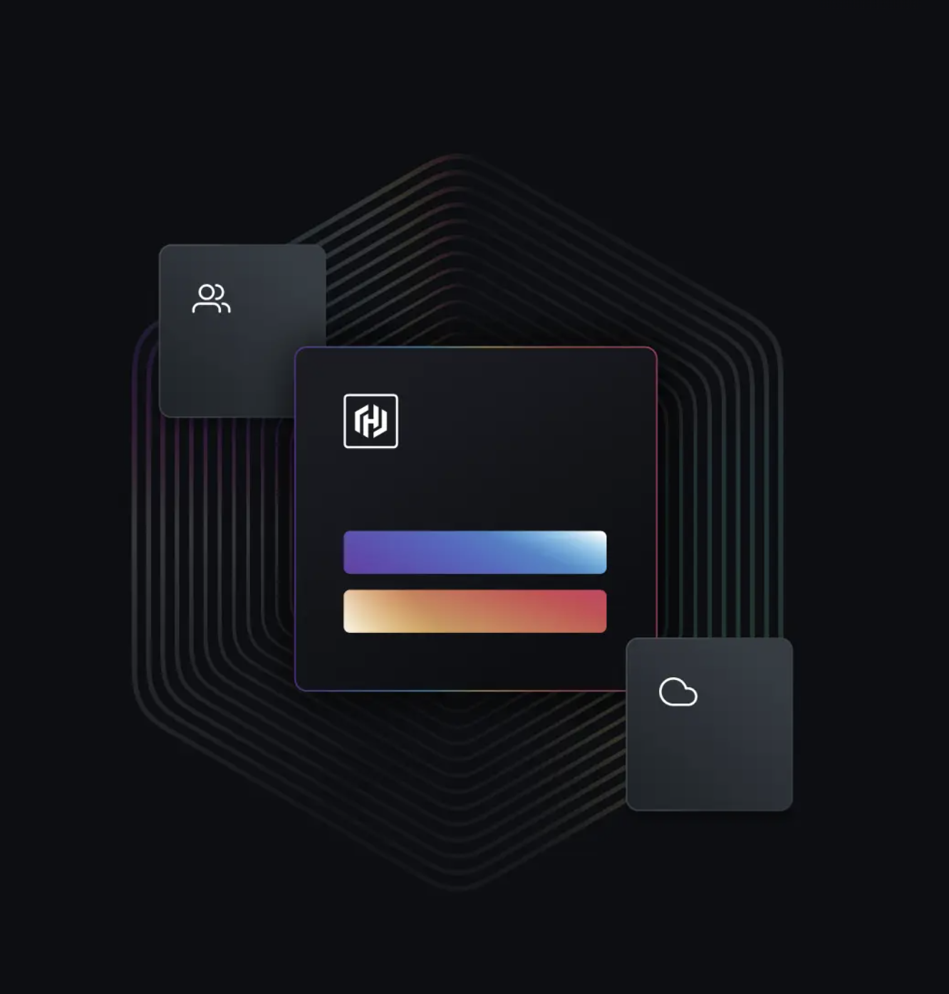
Contents
IBM HashiCorp Flexible Subscription License (FSL)
Introduction: What is it?
FSL T&C
How Credit Works / How to Process Early Terminations
FSL in ELAs
How FSL are financially treated, on the books
How FSL show up in ISC, EPM and IBM Quoting
How sellers are paid on FSL
Flexible
Subscription
Licenses

Slide 3





Flexible Subscription License – Introduction I/II
IBM HashiCorp Flexible Subscription Licenses
Flexible Subscription Licenses (FSL) is a new license type for IBM HashiCorp self managed parts (= on premise software which can be downloaded and installed anywhere).
IBM FSL follows the approach of HashiCorp pre acquisition. Their customers who license self managed software currently can terminate for convenience.
Unlike standard IBM Subscription Licenses, Client may terminate IBM Flexible Subscription License term early by giving IBM at least 30 days' written notice. Client will receive a prorated credit for any whole months remaining in a prepaid term. The credit can then be applied against future purchases of IBM Software and will expires 12 months after the issuance of the credit.
Offerings | Description
Terraform | Automate infrastructure lifecycle management
Nomad | Build, deploy, release process for consistency, across platforms & tools
Vault | Identity-based secrets and encryption management system as a service
Boundary | Secure remote access with authentication of trusted identity
Consul | Enables microservices communication across distributed environments
IBM HashiCorp Self Managed Offerings with Flexible Subscription License types.
HashiCorp Parts and Pricing Deck on Seismic

Slide 4
Flexible Subscription License – Introduction II/II
IBM HashiCorp Flexible Subscription Licenses
Flexible Subscription Licenses, behave from an ordering perspective like the standard IBM Subscription License model (ordered with D parts only), but FSL are cancellable. Refer to the FSL T&Cs on the next page.
FSL transactions are set to Terminate at End of Term, with Billing frequency as Annual or Upfront, and an End date is end of month – 1.
There is a difference in the Bill of Material (BOM) revenue split. Where the non-cancellable Subscription License allocate a % of the TCV to the License and to the S&S. The FSL has no transactional revenue and all revenue is ratable.
Source

Slide 5

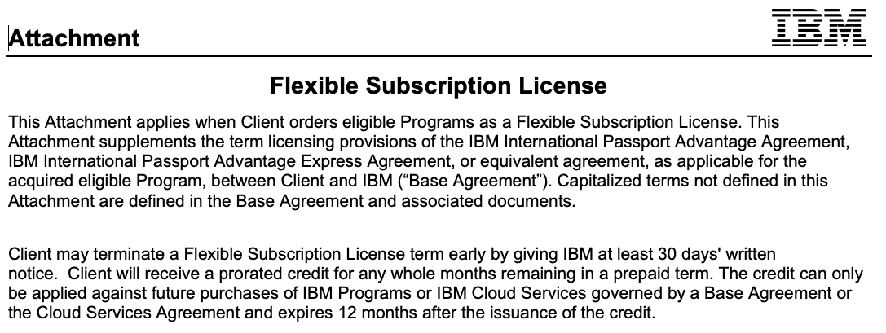
Flexible Subscription License T&Cs
T&Cs
Quotes created in IBM Quoting for IBM HashiCorp Self-Managed Subscription will include link to IBM Flexible Subscription License Attachment.
Link to IBM Terms

Slide 6
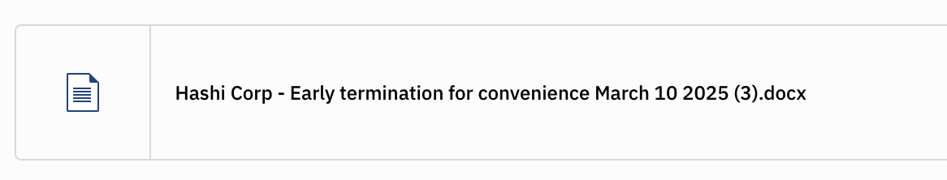
How Credit Works / How to Process Early Terminations
Credit Direct Deal
A Client that purchased Flexible Subscriptions directly from an IBM will have the credit issued by IBM.
Credit via Ecosystem:
A Client that purchased Flexible Subscriptions from an IBM authorized Business Partner will have the credit issued by IBM via the IBM Business Partner. Client should consult with its IBM Business Partner regarding use of the credit.
Use of Credit
The credit can then be applied against future purchases of IBM Software.
The credit expires 12 months after the issuance of the credit.
How to process early terminations
Instructions how an IBM employee can process an early termination in IBM Engage Support with customer mail
https://w3.ibm.com/w3publisher/subscription-license-q2c/flexible-subscription

Slide 7

FSL - Financial Treatment
This is how signings are recognized:
FSL drive Subscription License signings
FSL License signings are recognized upfront as Signings ACV. The full annual contract signing value is recognized upfront, not monthly.
Signings recognition occurs when firm order requirements are met, not when license keys are delivered which is usually a few days later.
This is how revenue is recognized:
No period revenue is associated with Flexible Subscription parts.
Revenue is ratable based on ‘Termination for Convenience’ language and books to the ledger monthly.
Example:
3-year contract with HashiCorp Flexible Subscription Licenses for 360k$ in total.
TCV signings = 360k$
ACV signings = 120k$
Period revenue = 0$
Over the contract duration, IBM will recognize 10k$ revenue each month.

Slide 8

ELA Quoting Considerations
It is important to work with the IBM Dealmaker PRIOR to suggesting to the client that HashiCorp can be included in an ELA and BEFORE any quote
IBM HashiCorp Self-Managed parts are based on Flexible Subscription Licenses (FSL) and can be sold only in fixed quantity only (p*q).
Inclusion in Unlimited License Agreements is not approved by the business unit.
Products based on FSL cannot be included in an ELA Catalog with perpetual parts without driving the catalog towards ratability.

Slide 9
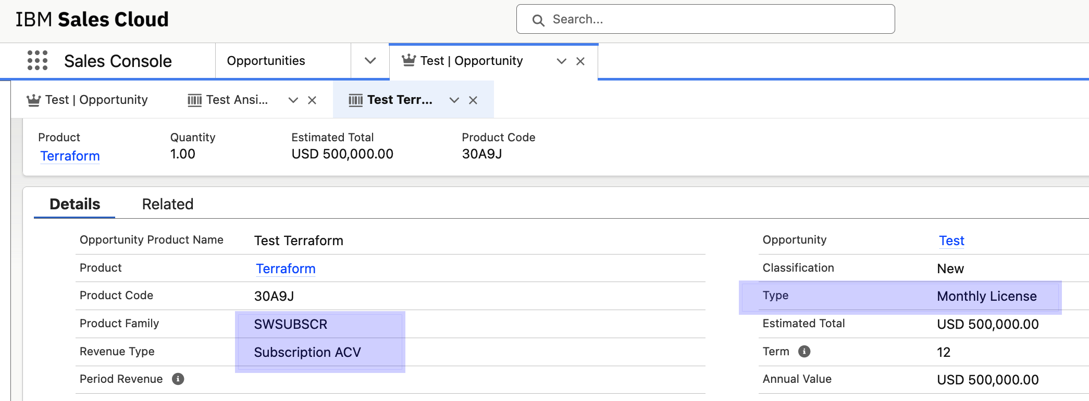
Forecasting: ISC Guidance for FSL
IBM HashiCorp Self-Managed Parts are based on Flexible Subscription Licenses. For forecasting in ISC please use
Product family = SWSUBSCR (SW Subscription)
Type = Monthly License
Revenue Type = Subscription ACV

Slide 10
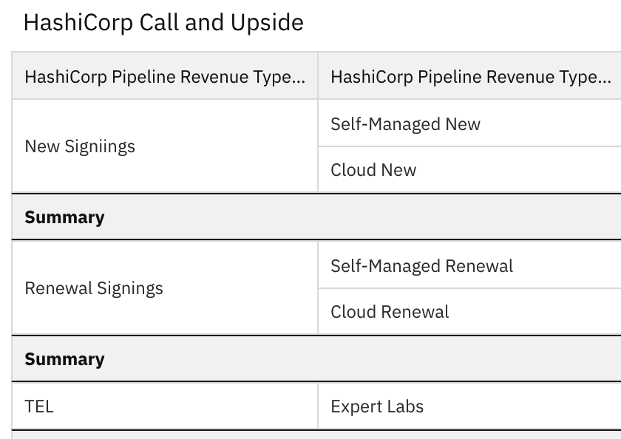
HashiCorp Revenue Reporting (ISC and EPM)
Currently, in HashiCorp we recognize 3 main lines of business:
“Self Managed” (Subscriptions),
“Cloud” (SaaS) and
“Expert Labs”.
These three can be further divided into the two signings categories:
“New Signings” and
“Renewal Signings”.
IBM HashiCorp “Self Managed” represents the 100% ratable licenses which the seller guidance has prompted reps to code as
Product Family Software Subscription (SWSUBSCR) with
Contract Type Monthly License (TYPEMNL).
This combination will force this opportunity to be excluded from the transactional measurements and be placed under “HashiCorp Self Managed” bucket in Signings.
More details: HashiCorp Forecasting Guide on Seismic.
Link to ISC HashiCorp Topsheet
Link to ISC SaaS ACV Roadmap
Link to Pipeline Summary for Sales in EPM (EPM1-001)
Link to EPM HashiCorp Topsheet

Slide 11
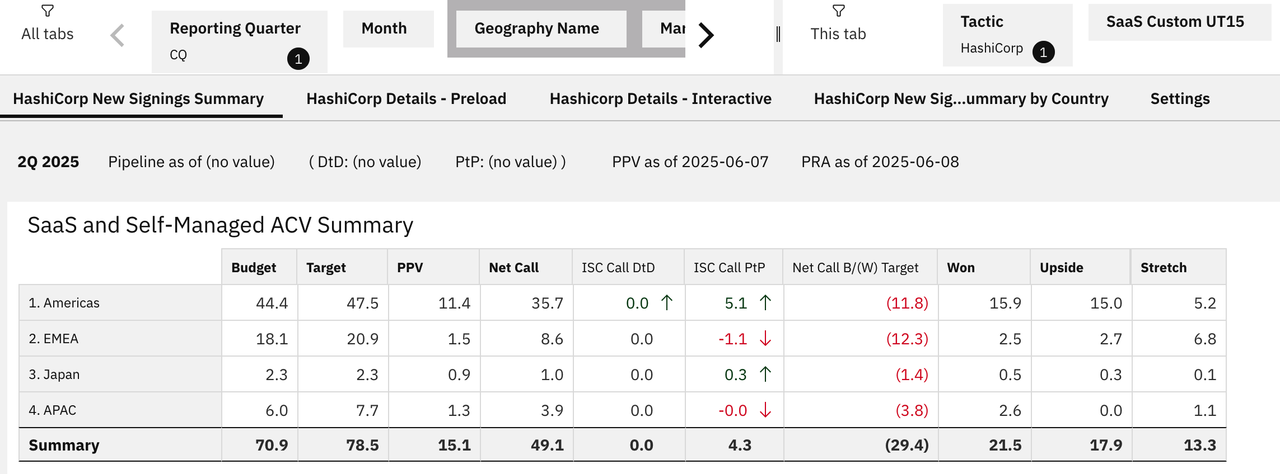
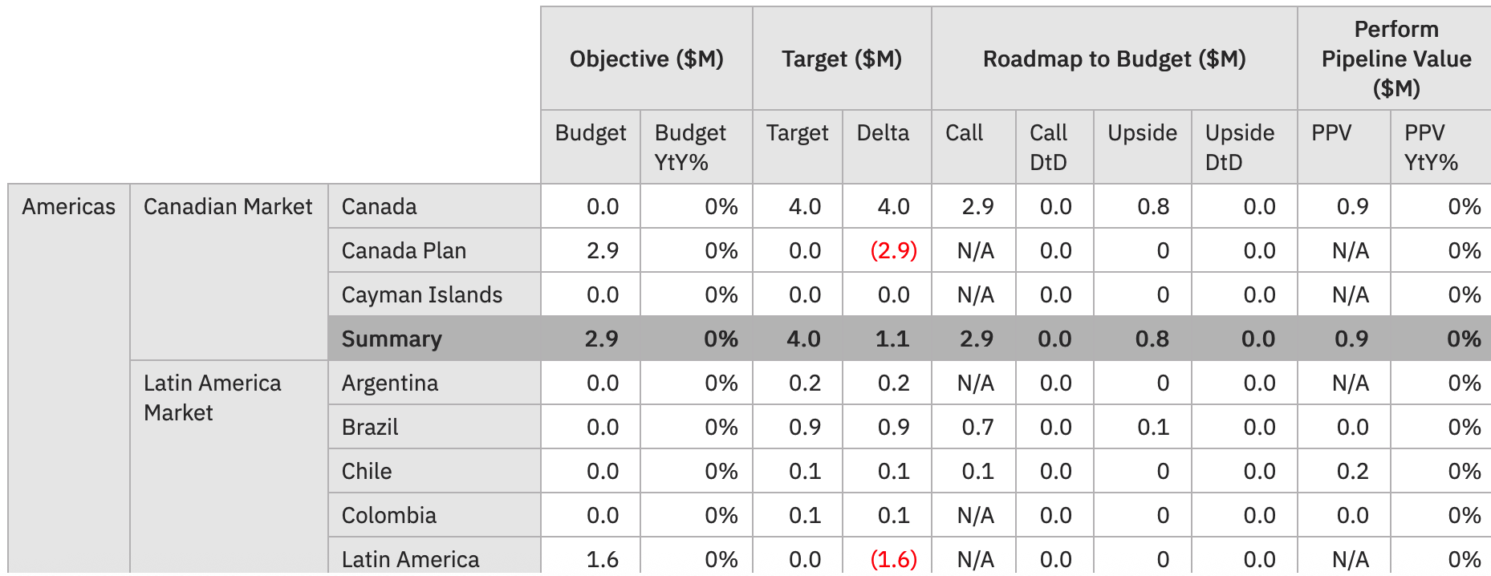
EPM Example: HashiCorp Topsheet
EPM HashiCorp Topsheet (https://ibm.biz/HashiCorpTopsheet)
ACV signings from IBM HashiCorp Flexible Subscription Licenses are included.

Slide 12
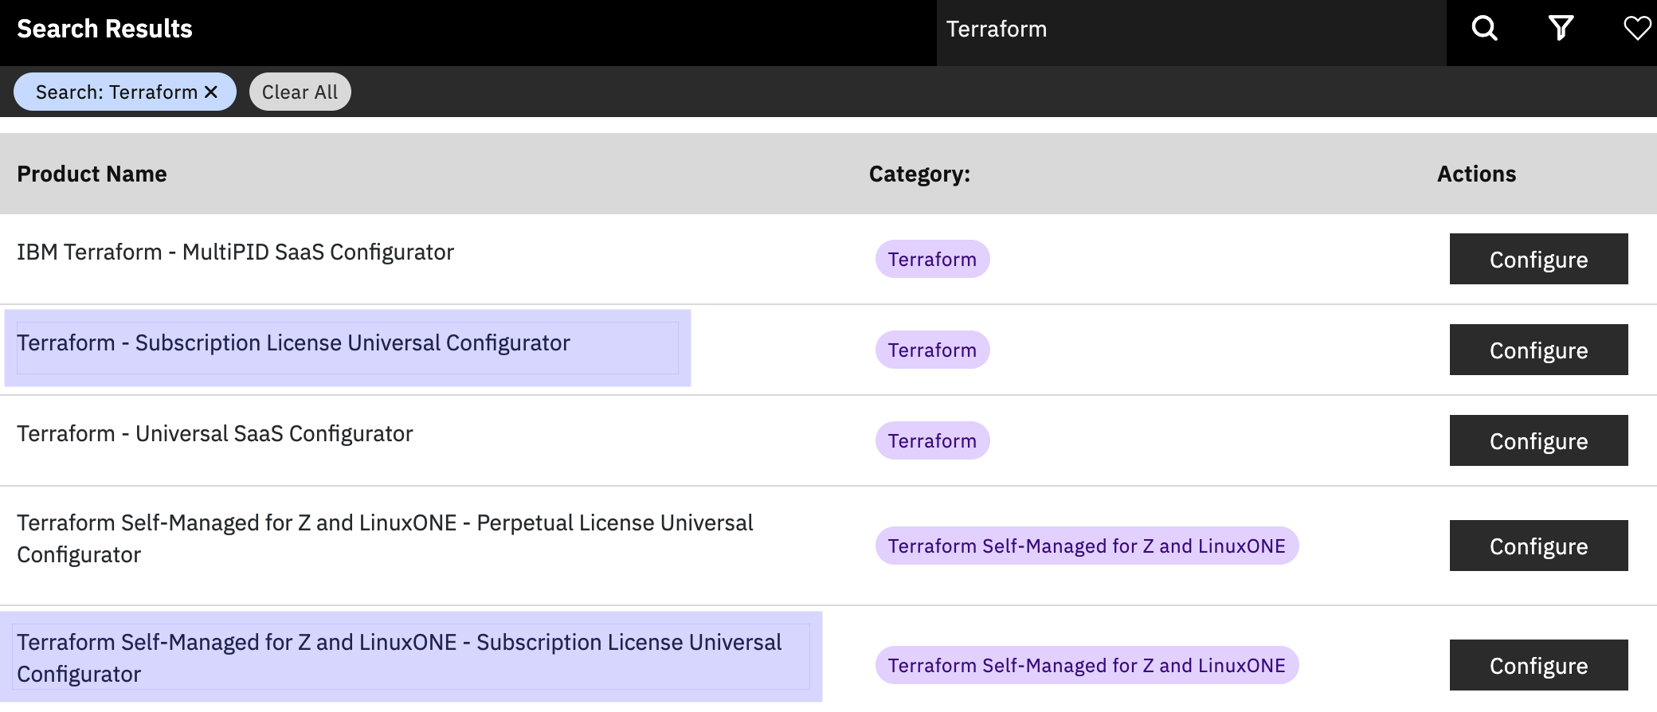
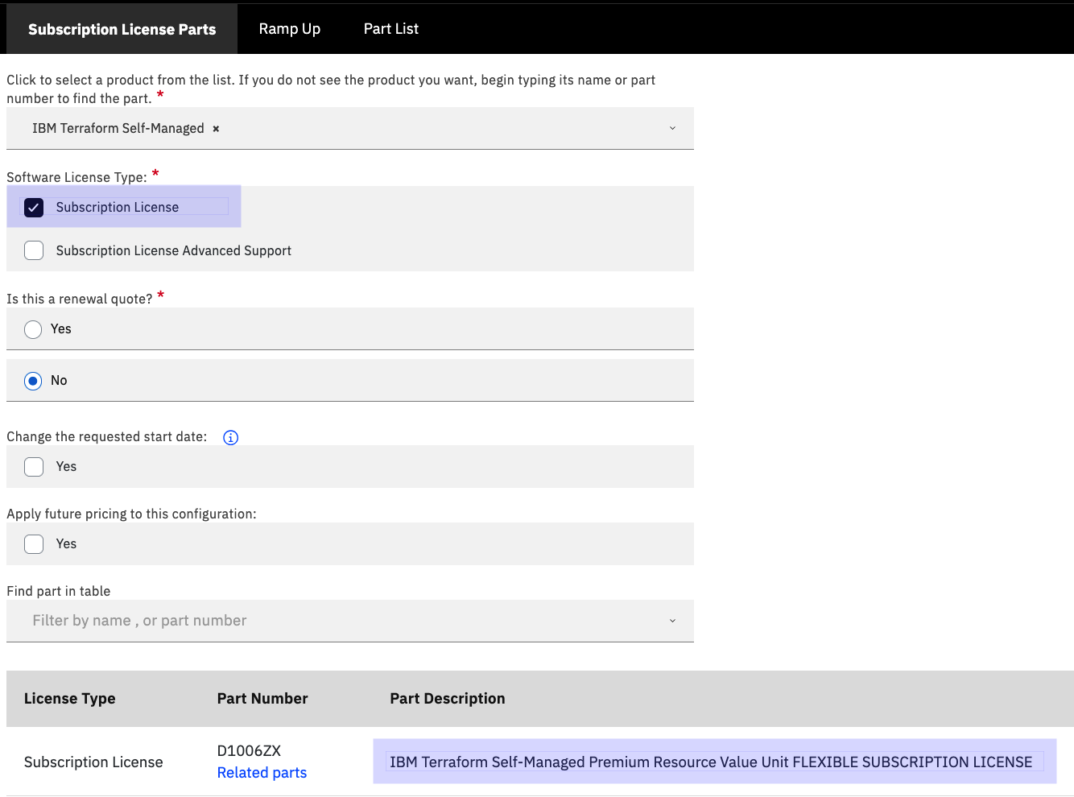
FSL in IBM Quoting
In IBM Quoting search for the IBM HashiCorp offering and select subscription license configurator. This will add the FSL to the quote.
Offerings
Terraform
Nomad
Vault
Boundary
Consul

